Slide 1
Equivalent machines
Two machines are said to be equivalent if they print the same output string when the same input string is run on them.
Two Moore machines may be equivalent. Similarly two Mealy machines may also be equivalent, but
A Moore machine can’t be equivalent to any Mealy machine. However, ignoring the extra character printed by the Moore machine, there exists a Mealy machine which is equivalent to the Moore machine.

Slide 2
Theorem
Statement:
For every Moore machine there is a Mealy machine that is equivalent to it (ignoring the extra character printed by the Moore machine).
Proof:
Let M be a Moore machine, then shifting the output characters corresponding to each state to the labels of corresponding incoming transitions, machine thus obtained will be a Mealy machine equivalent to M.

Slide 3
Note
It may be noted that while converting a Moore machine into an equivalent Mealy machine, the output character of a state will be ignored if there is no incoming transition at that state.
A loop at a state is also supposed to be an incoming transition.
Following is the example of converting a Moore machine into an equivalent Mealy machine

Slide 4
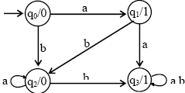
Example
Consider the following Moore machine
Using the method described earlier, the above machine may be equivalent to the following Mealy machine

Slide 5
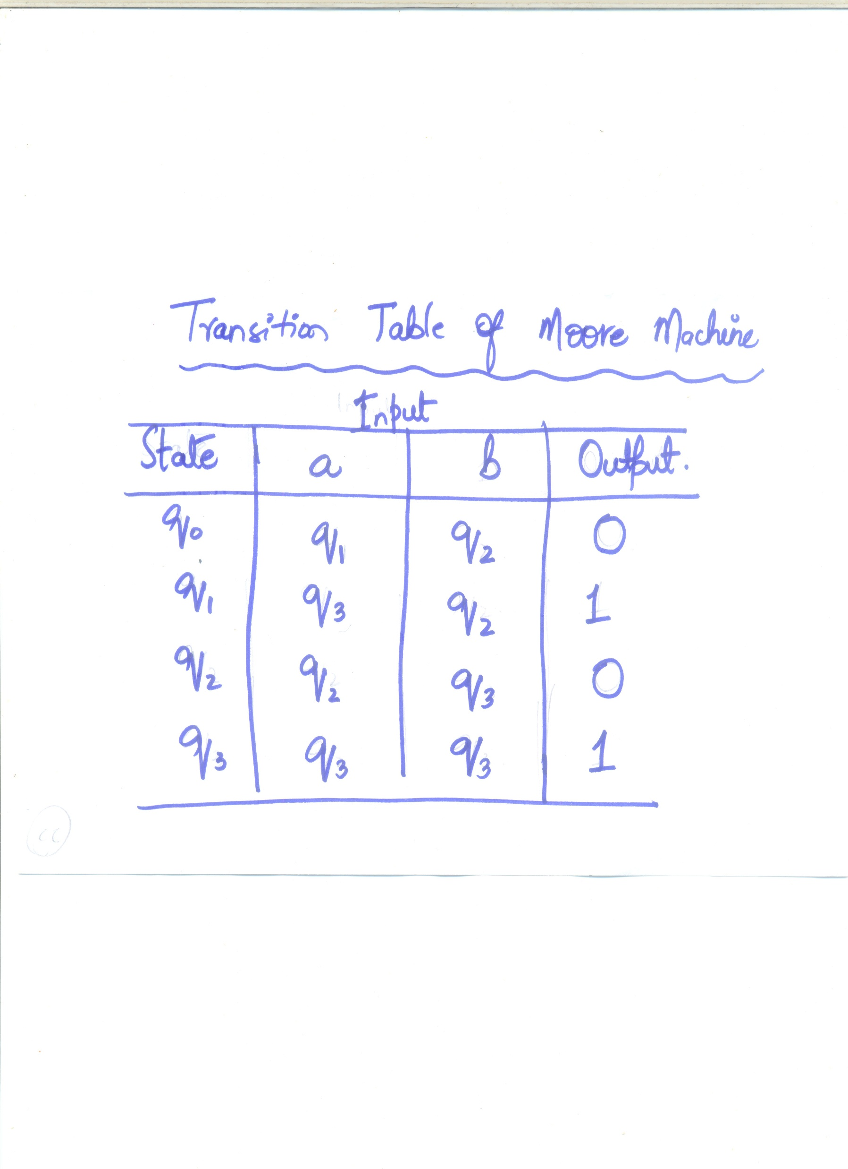

Slide 6

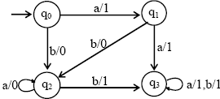
Example Cont…
Running the string abbabbba on both the machines, the output string can be determined by the following table

Slide 7
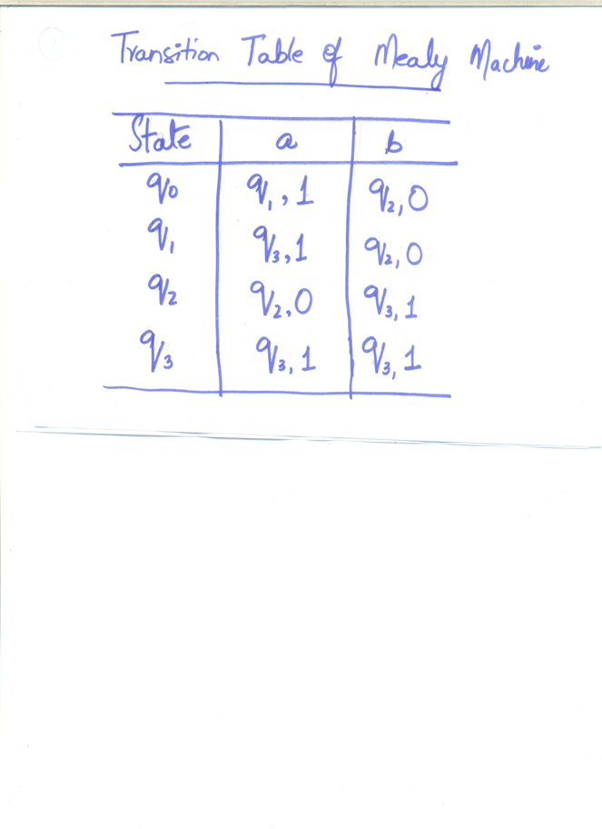

Slide 8
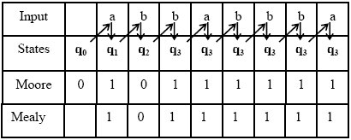
Example Cont…

Slide 9
Theorem
Statement:
For every Mealy machine there is a Moore machine that is equivalent to it (ignoring the extra character printed by the Moore machine).

